Slide 1
Insights from Personal Photos
How do we extract personality traits?
Youhee Choi, Jackie Kim, Yuntao Wang, Kexin Huang, Jeff Gonda, Kevin Feng

Slide 2
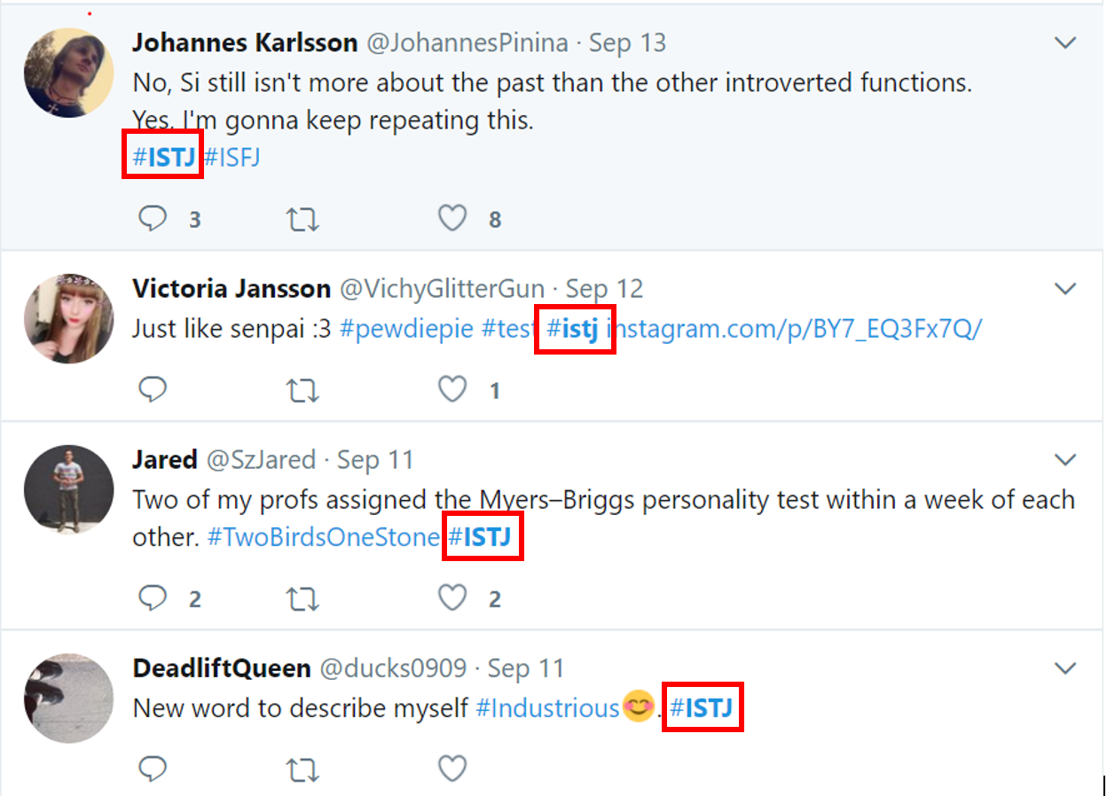
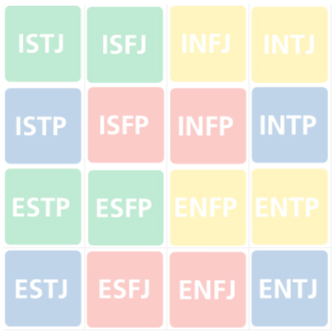
Insights from Personal Photos
<< Method >> Use Twitter API to scrape individual tweets
<< Focus >> Self-identified Myers-Brigg personality grouping
<< Analysis >> Match personality types with Twitter profile pictures
<< Purpose >> Utilize for targeted marketing by building a platform
16 MBTI Personality Types
Examples

Slide 3
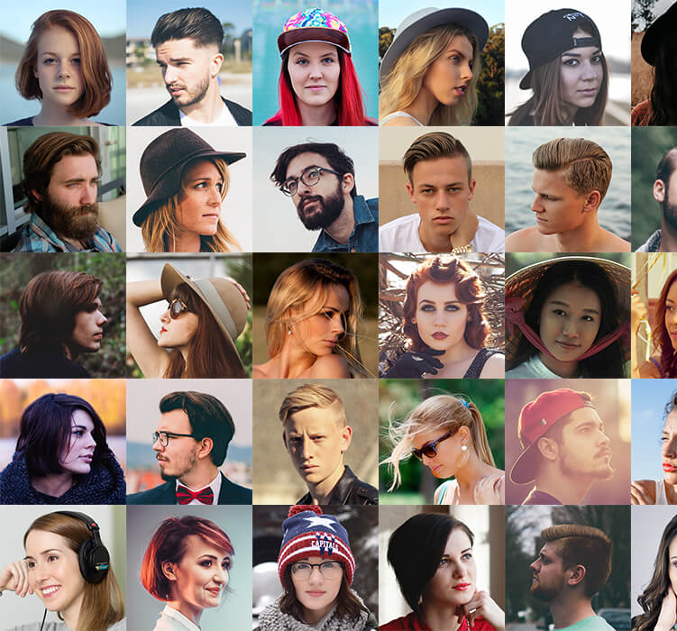
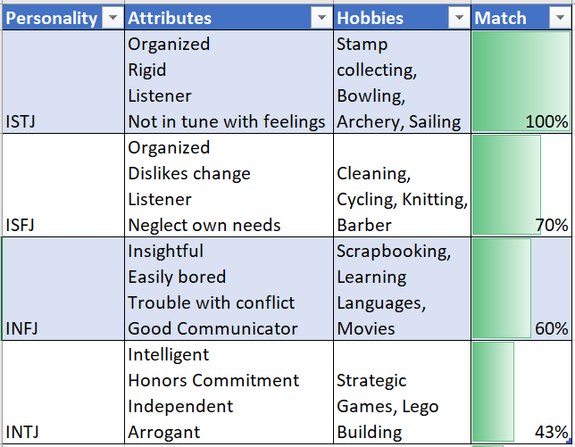
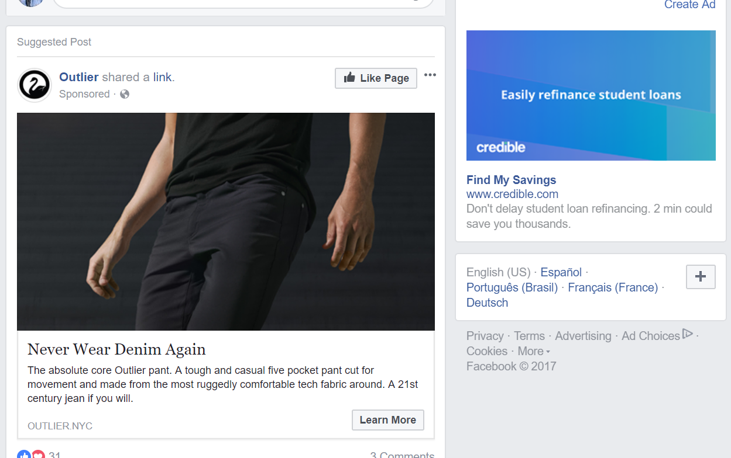
User Perspective
User Interface
Data analytics for targeted marketing
How is personality related to photos, then to marketing strategies?
Top 3 User Requirements
Ease of use / understandability
Quick performance
Profitability and increase CTR
Input
Output
Business Use

Slide 4
Technical Components by priority
Algorithms: Deep Learning / Image classification
APIs: Twitter API to scrape personality data (Myers-Brigg) and profile pictures
Dashboard: visualizing the analytics in a way suited for targeted marketing
UI: intuitive ease of use
Filtering/Classification: methodologies for tagging photos

Slide 5
Technical Architecture
Possible Inputs Code Blocks
Possible Output Code Blocks
Compute including test, train, split
Stream Social Net
Deep Learning algorithms, image classifier training, feature extraction
Web
Download
Desktop
Crawl
Cloud Data Portal
Pandas
Short Term Storage
SQL, Excel, and Cloud Storage
Long Term Storage
Feedback from Companies/Customers

Slide 6
What’s Next?
Week 1
Week 2-3
Week 4-6
Week 7-8
Data Acquisition
Youhee, Jackie
Contact Mentor
Pre-process
Kevin, Yuntao
Twitter API
Algorithm building
Kexin, Jeff
Deep-learning
Algorithm Practice
Yahoo’s photo DB
Biz model
Study targeted marketing methods
Data Analysis
Twitter Profiles
& Personality
Build UI model
For clients to use for marketing
Finalize analysis
Test in market

